Slide 1
Chapter 9, Part 2
Regression with Categorical Predictors Using Indicator Variables

Slide 2
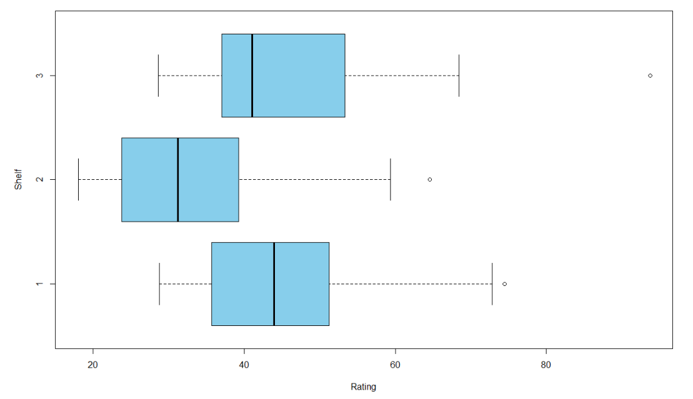
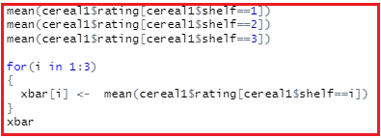


Example from Cereals: variable shelf
Shelf: supermarket shelf cereal located on, 1, 2, or 3 (Not quantitative!)
Do you think that the supermarket shelf on which a box of cereal is placed can tell you anything about its nutritional rating?

Slide 3
Representing shelf with indicator (dummy or flag) variables
A categorical variable with m outcomes will be represented in a model with m – 1 indicator variables.
For our shelf variable, we’ll use two indicator variables: shelf1 and shelf2 defined as follows:
Using these two variables, how do we know if the cereal we are interested in is on shelf 3 in the supermarket?
It’s on shelf 3 if shelf1 = 0 and shelf2 = 0.
The outcome that is not assigned an indicator variable will serve as the reference category. So, shelf 3 will be our reference category.

Slide 4

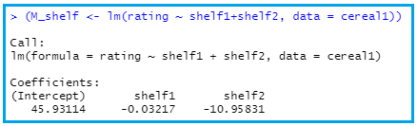
Construct a multiple regression model for rating using shelf1 and shelf2 as the predictor variables.
Create the indicator variables:
Fit a linear regression model to ratings using the indicator variables.
Interpretation: coefficient of shelf2 = difference between mean ratings for shelf 2 – mean ratings for reference shelf, shelf 3.

Slide 5
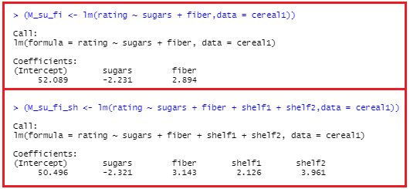

Fitting model for rating using predictors shelf1, shelf2, sugars, and fiber

Slide 6
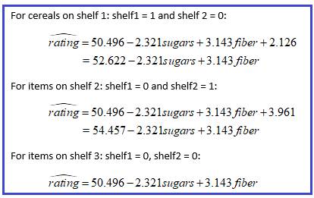

Model:

Slide 7
But I thought that cereals with the lowest nutritional rating would be on shelf 2 (at kids’ eye levels)!

Slide 8
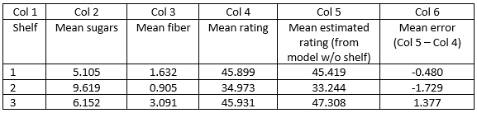
Taking Closer Look
The model based on sugars and fiber alone:
underestimates rating of shelf 2 cereals, on average, by 1.729 points.
overestimates rating of shelf 3 cereals, on average, by 1.377 points.
Note Relative estimation error: difference between shelves 2 and 3 is
1.377 – (-1.729) = 3.106.
Thus, we would expect that if shelf location were going to compensate for the underestimate of shelf 2 cereals relative to shelf 3 cereals, it would add around 3.1 rating points (Based on model that included shelf, it added 3.961 points.)
Notes:
Column 5: Looked at predicted (or fitted values) for rating using linear model that includes only sugars and fiber (not the indicator variables). Something interesting has happened here. Take the difference between Col 5 and Col 4. What we see for the cereals on shelf 2, this model has underestimated the nutritional rating by, on average, 1.729 points. On the other hand, for the cereals on shelf 3, this model has overestimated the nutritional rating by, on average, 1.377 points.

Slide 9
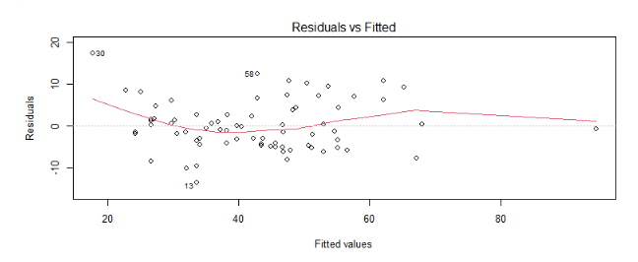
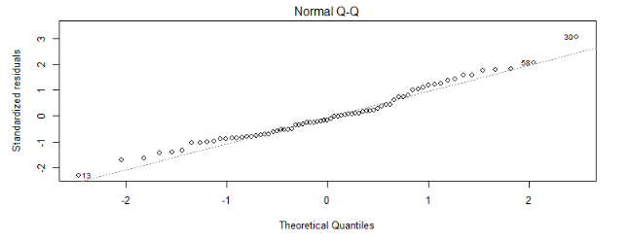
Return to model with sugars, fiber, shelf1 and shelf2
Residual plots

Slide 10
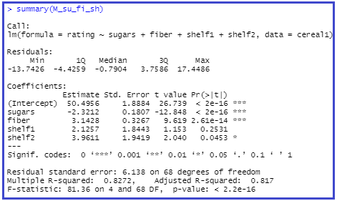



Coefficients significant?

Slide 11
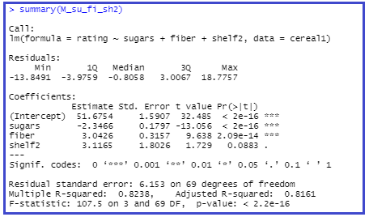

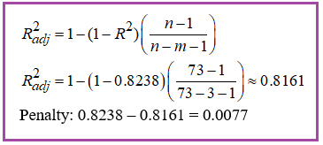
Removing shelf1 from model

Slide 12
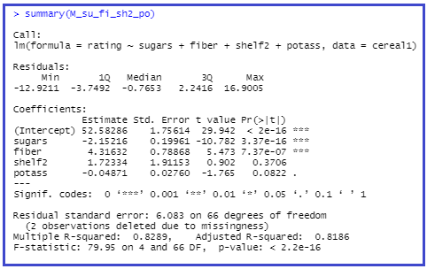
Continuing to build the model: introduce new variable potass

Slide 13
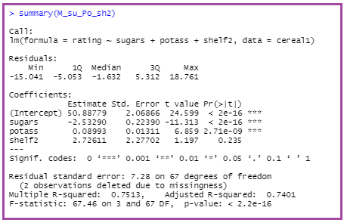

Model: swap fiber for potass

Slide 14
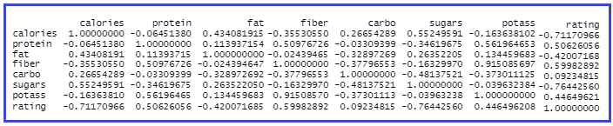
Multicollinearity
Next, we look at information provided in the sequential sums of squares to help us get a better idea of which variables to include in the model.

Slide 15

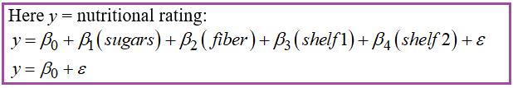

Sequential SS: Breakdown of SSR (SS_{regression})
Recall:

Slide 16
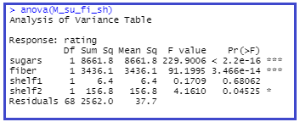


Sequential SS (continued)

Slide 17
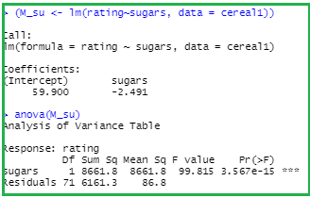
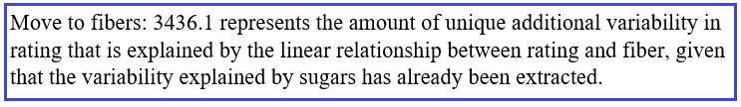
Sequential SS (continued): To start, look at sugars

Slide 18
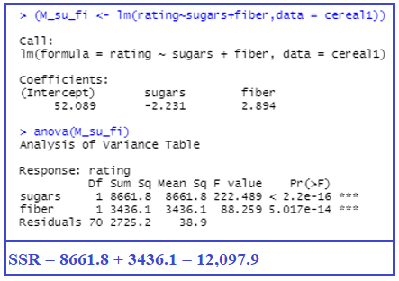


Sequential SS (continued): Moving on to fiber

Slide 19
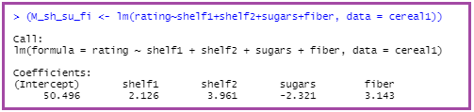
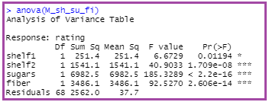
Suppose we change the ordering of the variables
Changing the ordering of the variables entered into the model will not change the coefficients of the model, but it will change the sequential sums of squares:
Indicator variables able to “claim” their unique portions of the variability before the other variables are entered, giving them larger values in the sequential SS.

Slide 20
Variable Selection Methods
We can use the sequential SS in partial F-tests, which can be used in variables selection.
Several variable selection methods available
Assist analyst in determining which variables to include in model
Algorithms help select predictors leading to optimal model
Four variable selection methods: (1) Forward Selection (2) Backwards Elimination (3) Stepwise Selection (4) Best Subsets

Slide 21
The Partial F-Test
Some selection methods use partial F-Test
Suppose model has x₁,…,x_{p} predictors and we consider adding additional predictor x* (example: x₁ = sugars and x₂ = fiber; want to add x* = shelf1)
Now, we calculate sequential sum of squares from adding x*, given existing x₁,…,x_{p} in model (example: fit model with sugars, fiber, and shelf1)
Full sum of squares SS_{Full} = x₁,…,x_{p,} x* in model (SSR for model with sugars, fiber, shelf1)
Reduced sum of squares SS_{Reduced} = x₁,…,x_{p} in model (SSR for model with sugars and fiber)
Therefore, extra sum of squares SS_{Extra} denoted by

Slide 22
The Partial F-Test (cont’d)
Null hypothesis for Partial F-Test
Ho: No, SS_{Extra} associated with x* does not contribute significantly to model
Ha: Yes, SS_{Extra} associated with x* does contribute significantly to model
Test statistic for Partial F-Test follows F_{1, n-p-2} distribution when Ho true
Therefore, Ho rejected for small p-value
Equivalent to t-tests for individual coefficients: F_{1, n-p-2} = (t_{n-p-2})²

Slide 23
The Partial F-Test: Comparing Sequential and Partial SS
For sequential SS ordering of variables entering model germane to method
Ordering not relevant to partial sum of squares
Table shows difference in two methods for model with predictors x₁,…,x₅
Variable | Sequential SS | Partial SS

Slide 24
Forward Selection Procedure
Procedure begins with no variables in model
Step 1:
Predictor x₁ most highly correlated with response selected
If model not significant, stop and report no predictors important
Otherwise, proceed to Step 2
Step 2:
For remaining predictors, compute sequential F-statistic given predictors already in model
For example, first pass sequential F-Statistics computed for F(x₂|x₁), F(x₃|x₁), F(x₄|x₁)
Select variable with largest sequential F-statistic

Slide 25
Forward Selection Procedure (cont’d)
Step 3:
Test significance of sequential F-statistic, for variable selected in Step 2
If resulting model not significant, then stop reporting model without variable selected in Step 2
Otherwise, add variable from Step 2, and return to Step 2

Slide 26
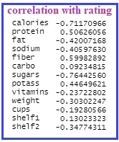

Apply Forward Selection to Cereals
Before we get started, we can use the correlation table to decide which variable goes in first.

